Slide 1
Finger Language
Recognisation
for Remote Communication
Prosenjit Das
Kaibiao Ruan

Slide 2
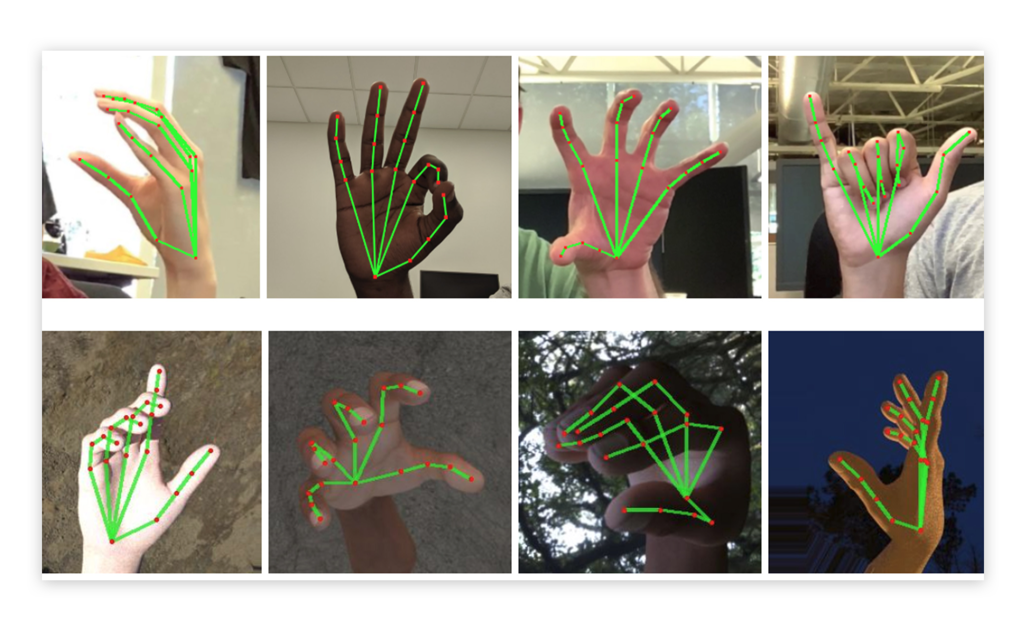
Finger Language Recognization
Inspiration : Helping Blind or Deaf to get technological experience by standard finger language gesture. Also, people working in High Noise environment or Biomedical lab , where employees are prefer to communicate remotely without touch

Slide 3


1. Intro
Finger Language can communicate with
Google API / Chat GPT Browse Web
Control IOT Devices Remotely Control by remote command
Single Remote Device Same language multiple devices
Finger to Native Language Help Language Conversion

Slide 4
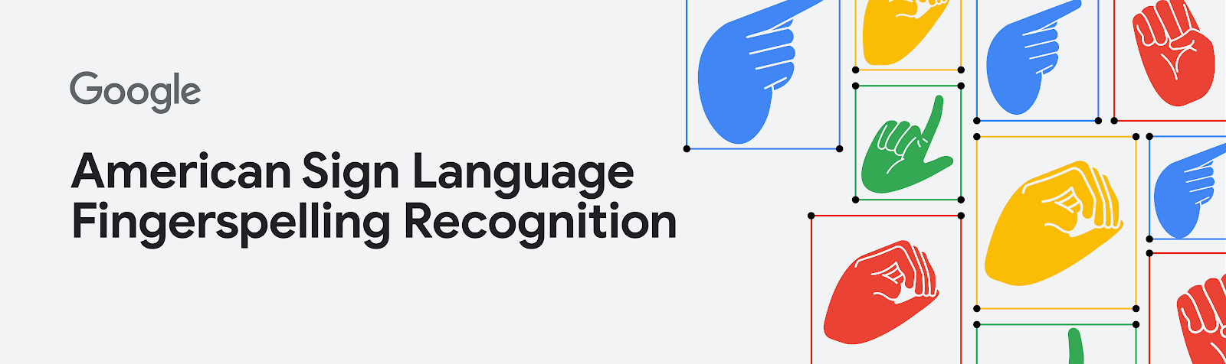
Collected Standard Dataset from Google Kaggle

Slide 5
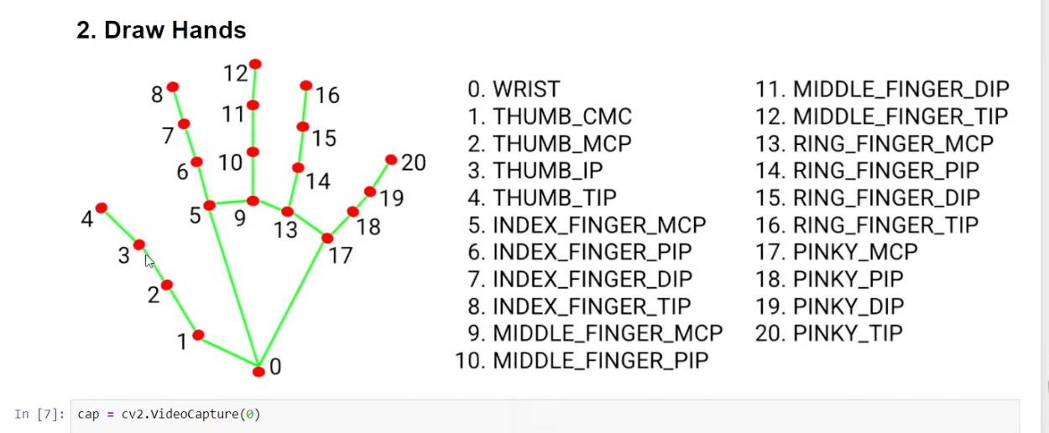
Standard Finger Coordinates
Tip
Remember. If something sounds like common sense, people will ignore it.
Highlight what is unexpected about your topic.

Slide 6
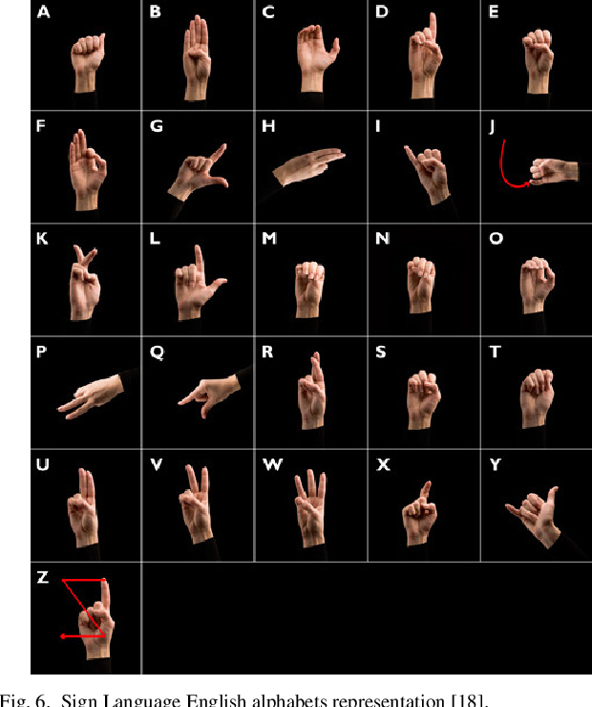
MediaPipeline captures finger position and co-ordinate. Once co-ordinates have enough data, pass that information to Tensorflow ML model to build single command.

Slide 7
Milestones
October 2014
October 2015
August 2015
November 2015
Build ML Model
Integrate with Hardware
Aug-Sep |  |  |  | 2023
Train TensoflowLite for IOT Devices
ML on Customized Hardware

Slide 8
Technology
Kaggle Dataset
Media Pipeline
Tensorflow / Python

Slide 9
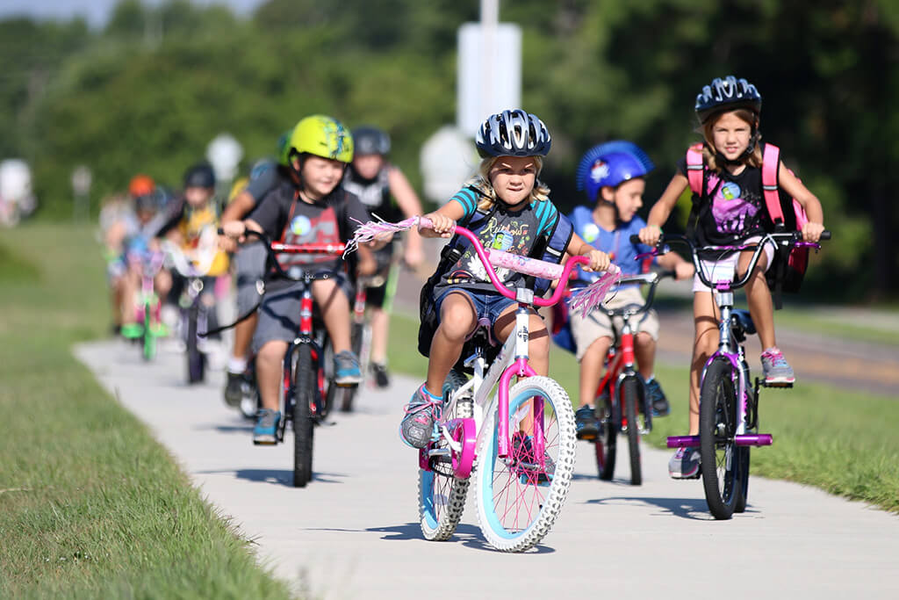
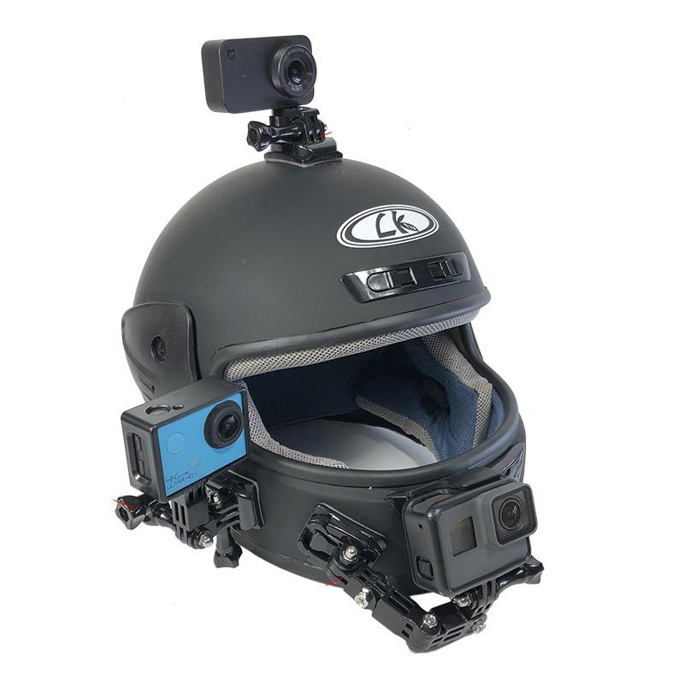
Helmet

Slide 10
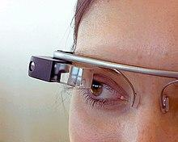
Google Specs

Slide 11
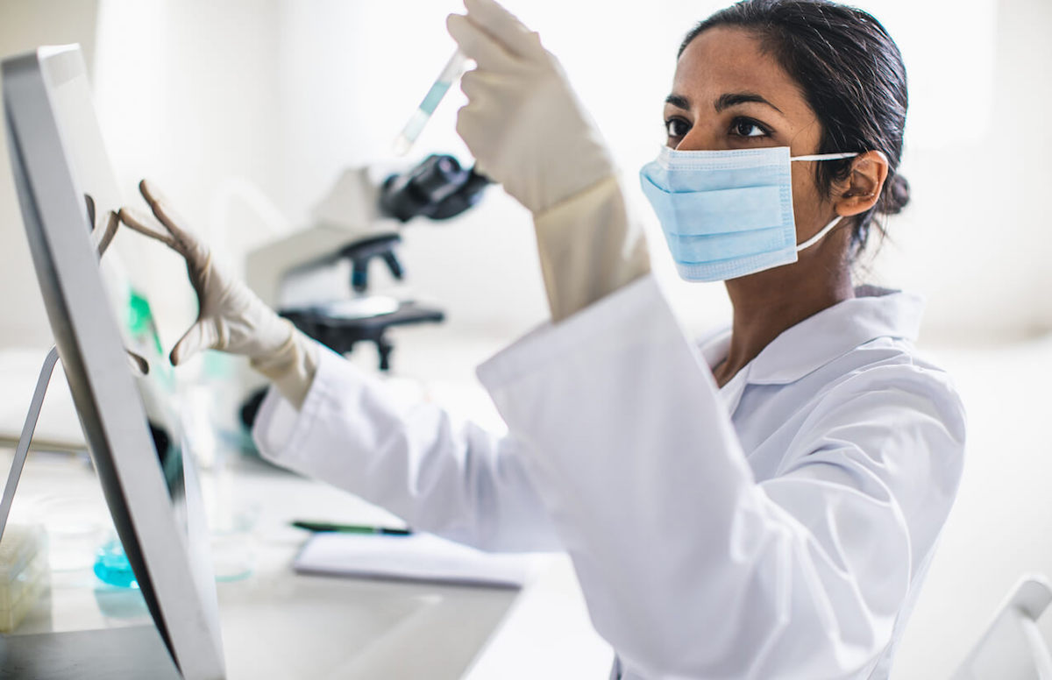
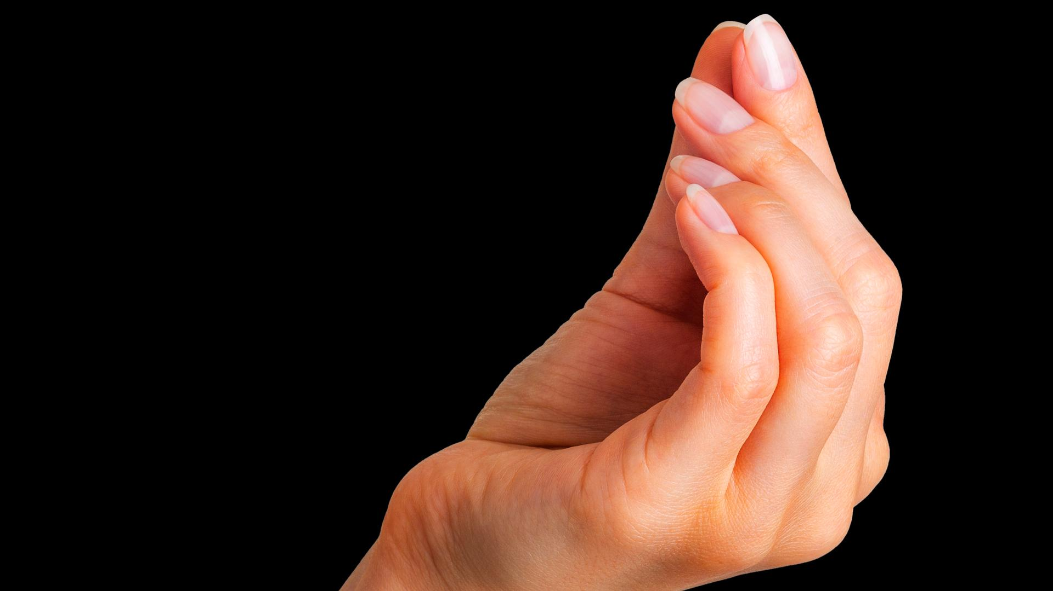
Bio-laboratory

